Slide 1
Subject | Life skills
Grade | 2 year 1
Term | 3

Slide 2
LESSON PLAN CONTENT
Week 1 -3 | TRANSPORT
Week 4-5 | ROAD/TRAFFIC SAFETY
Week 6-7 | PEOPLE WHO HELP US IN OUR COMMUNITY
Week 8-9 | FRUITS AND VEGETABLES

Slide 3
LESSON OBJECTIVES
Guide and support learners to achieve their full physical, intellectual, personal, emotional and social potential.
Teach learners to exercise their constitutional rights and responsibilities and to respect the rights of others.
Guide learners to make informed and responsible decisions (with support) about their health and environment.
Develop skills such as self-awareness, problem-solving, interpersonal relations, leadership, decision-making, and communication to the individual potential of the learner.
Develop learners’ skills to respond to real-life situations and play an active and functional role
in the economy and society.

Slide 4
ASSESSMENT GOALS
TRANSPORT | Understand what transport is Identify animal transport Identify road transport Compare the different types of transport
ROAD TRAFFIC SAFETY | Identify pedestrians Identify cyclists Identify passengers
PEOPLE WHO HELP US IN OUR COMMUNITY | Select people who help us in our community - such as clinic nurse, teacher and after-care teacher, traffic cop, police officer etc. Explain and give examples how different people help one another. Ask for assistance. Know who to contact when help is needed.
FRUIT AND VEGETABLES | • Identify Apple/banana/grapes/pear/peach/pineapple/orange/lemon/apricot/ plum/melon/ watermelon/guava/granadilla/mango. Identify Carrot/cabbage/bean/potato/pumpkin/onion/ beetroot/peas/sweet potato/butternut/ cauliflower/broccoli.

Slide 5
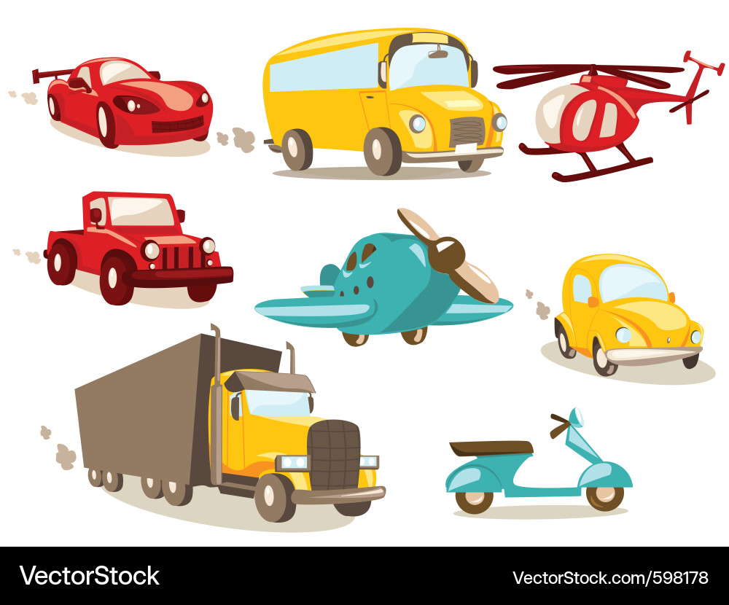
TRANSPORT

Slide 6
GROUP 1

Slide 7
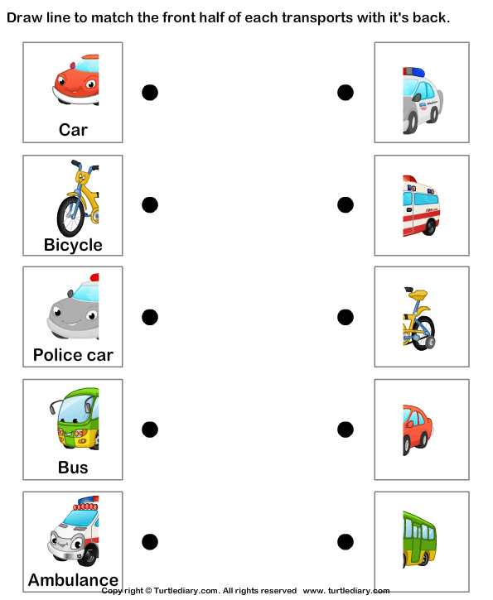

Slide 8
GROUP 2

Slide 9
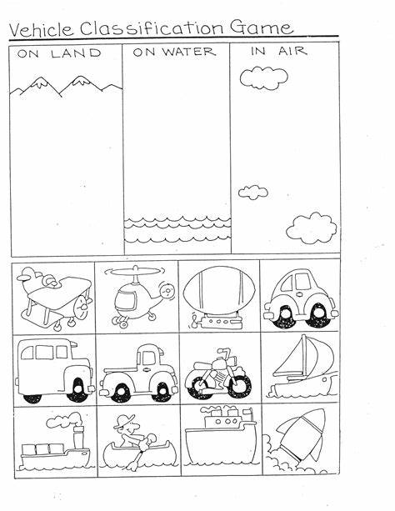

Slide 10
GROUP 3

Slide 11
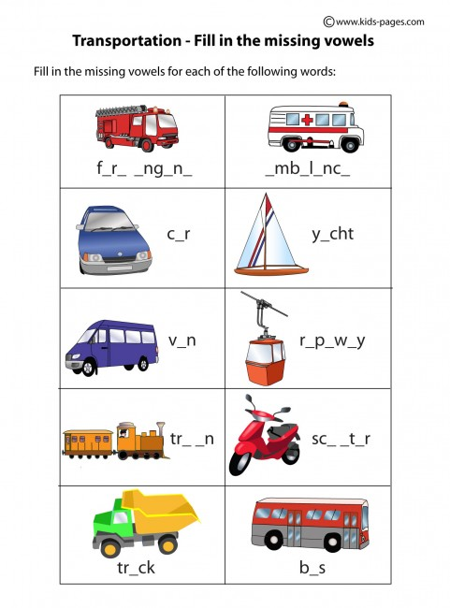

Slide 12
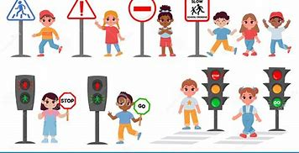
ROAD/ TRAFFIC SAFETY

Slide 13
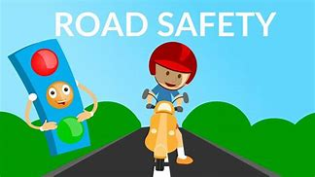

Slide 14
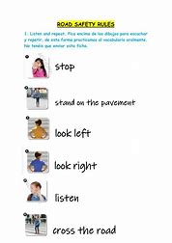

Slide 15
GROUP 1

Slide 16
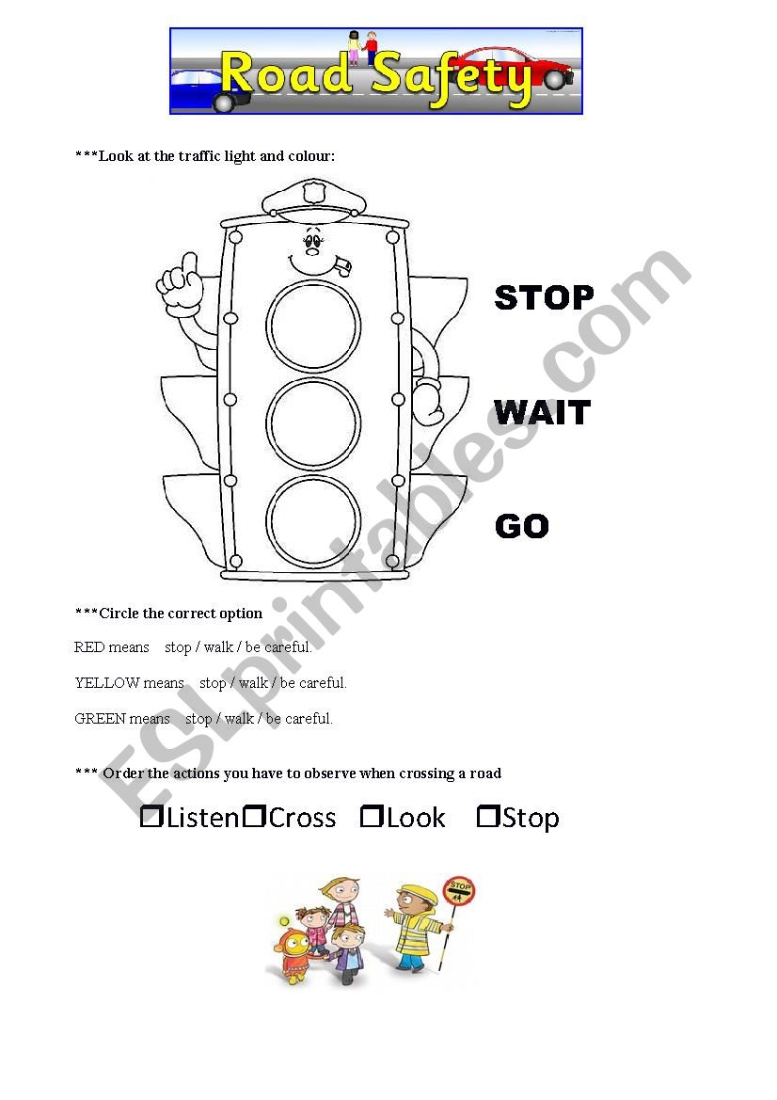

Slide 17
GROUP 2

Slide 18
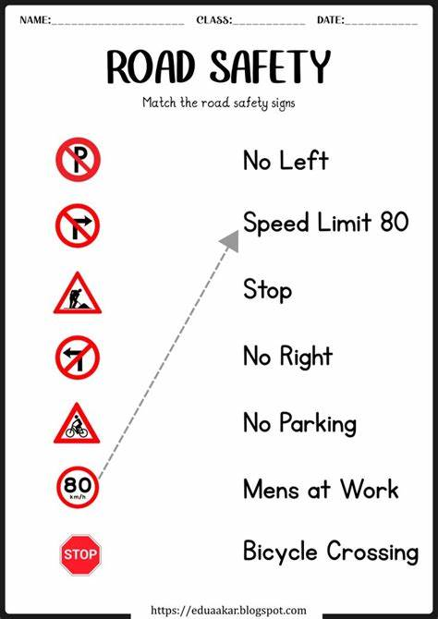

Slide 19
GROUP 3

Slide 20
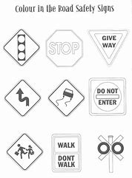

Slide 21
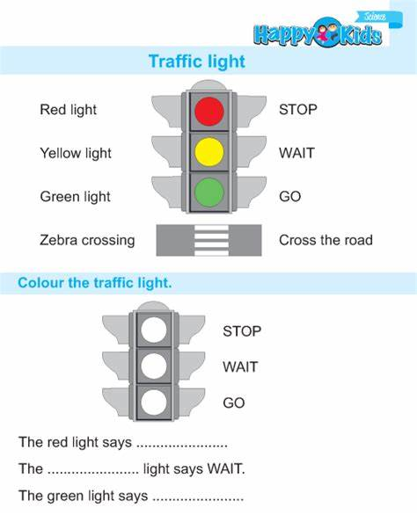

Slide 22
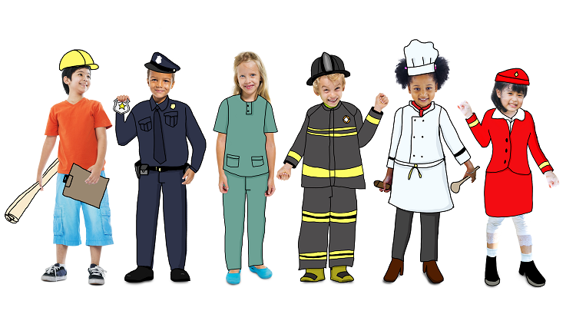
PEOPLE WHO HELP US

Slide 23
GROUP 1

Slide 24
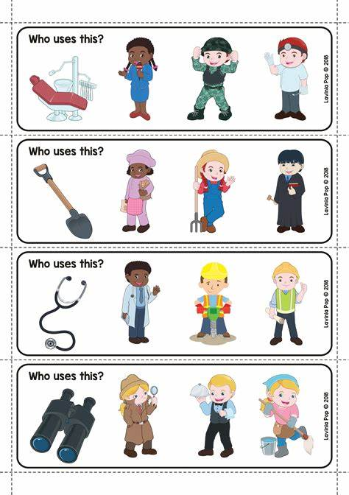

Slide 25
Group 2

